Slide 1
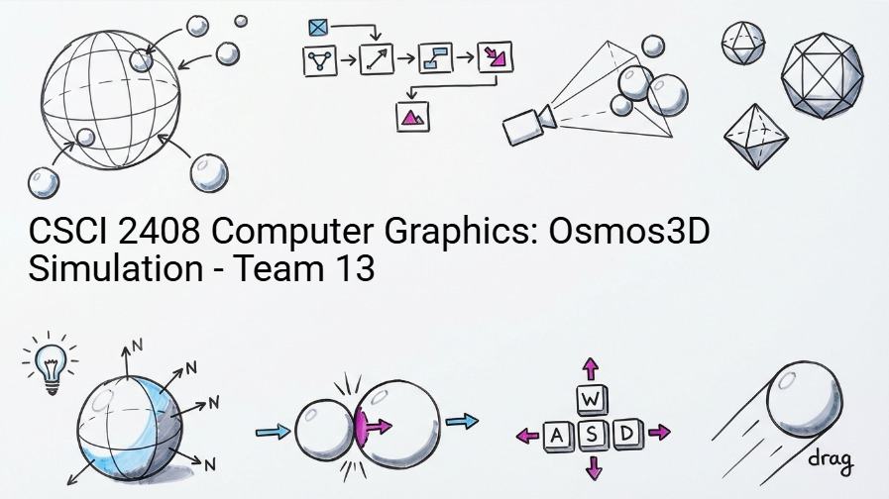

Cosmic Absorption: A Journey of Growth
Team 13: Laman Panakhova, Nigar Nazarli, Islam Ibrahimov
CSCI 2408 Computer Graphics - Fall 2025
Instructors: Dr. Araz Yusubov, Mr. Azar Aliyev
CSCI 2408: Computer Graphics
ADA University. School of IT and Engineering

Slide 2



Project Overview & Team Contributions
Game Concept
Team Contributions
A 3D simulation inspired by the Osmos game where players control a mote that absorbs smaller motes while avoiding larger ones.
Laman Panakhova
33%
Rendering Pipeline: Geometry, Textures, Camera
Key Features
Nigar Nazarli
33%
Shading & Lighting: Blinn-Phong Model
3D Rendering
Dynamic Lighting
Texture Mapping
Player Control
Physics Engine
33%
Islam Ibrahimov
Motions & Physics: Collision & Absorption
Absorption Mechanics
CSCI 2408: Computer Graphics
ADA University. School of IT and Engineering

Slide 3







Foundational Architecture: WebGL & JavaScript Integration
Core Technical Foundation
Our Osmos3D simulation is built on a WebGL-JavaScript architecture that provides real-time 3D rendering capabilities directly in the browser without plugins.
WebGL Context
Initializes viewport, enables depth testing, and configures alpha blending for proper 3D rendering
Key Components
Shader Programs
Compiles vertex and fragment shaders, linking them into a program for defining rendering behavior
WebGL Context
Shader Programs
Buffer Management
Game Loop
Local Server
Buffer Management
Implementation Insights
Creates VBOs, NBOs, and EBOs to efficiently store vertex, normal, and texture data
Our architecture uses requestAnimationFrame to synchronize rendering and physics updates, creating smooth gameplay. Running on a local server prevents CORS issues when loading textures, ensuring proper resource access.
Game Loop
Synchronizes rendering and physics updates using requestAnimationFrame for smooth gameplay
CSCI 2408: Computer Graphics
ADA University. School of IT and Engineering

Slide 4

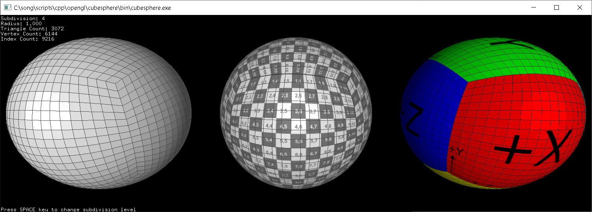

Rendering Pipeline: Advanced Sphere Geometry
Sphere Generation Technique
We implemented recursive octahedral subdivision to create smooth sphere meshes that provide realistic surfaces for our motes, enabling accurate lighting and texture mapping.
1
Octahedral Subdivision
Recursively subdivides an octahedron to create high-fidelity sphere meshes with smooth surfaces
GPU Optimization
2
Vertex & Normal Generation
Efficient Buffer Upload
Indexed Drawing
Procedurally calculates vertices, normals, and texture coordinates for accurate 3D representation
UV Seam Fix
The initBuffers function efficiently uploads all necessary data to the GPU, while indexed drawing minimizes data transfer and memory usage during rendering.
3
UV Mapping & Seam Correction
Implements techniques to address texture artifacts at sphere poles, ensuring seamless visuals
CSCI 2408: Computer Graphics
ADA University. School of IT and Engineering

Slide 5


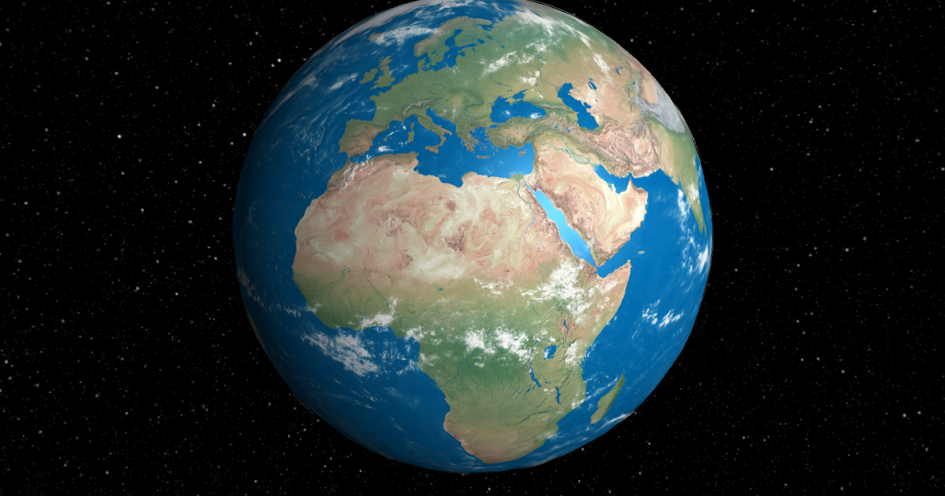


Rendering Pipeline: Dynamic Texture & Scene Composition
Texture Handling
Scene Composition
Our implementation uses asynchronous texture loading to prevent blocking the main rendering thread, ensuring smooth gameplay while textures load in the background.
Texture Configuration
Flips Y-axis for correct orientation, generates mipmaps for quality at varying distances, and applies filtering techniques for smooth transitions
The initScene function procedurally generates motes with randomized attributes while ensuring non-overlapping placement through iterative sampling and collision checks.
Asynchronous Loading
Implements configureTexture and loadTextures functions to load motes and skybox textures without blocking the main thread
Randomized Mote Placement
Skybox Integration
Non-Overlapping Algorithm
CSCI 2408: Computer Graphics
ADA University. School of IT and Engineering

Slide 6


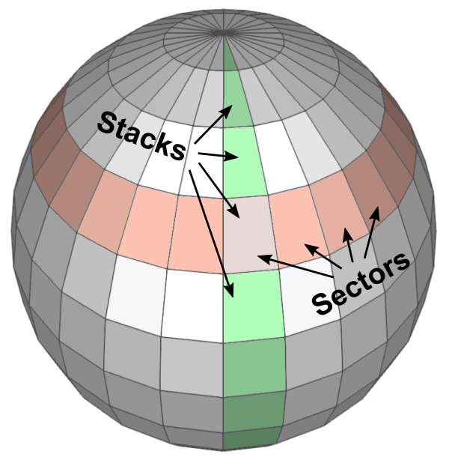


Rendering Pipeline: Interactive Camera & Draw Calls
Camera System
Draw Call Management
Our implementation features a mouse-driven orbit camera that dynamically adjusts position based on user input, creating an immersive experience that tracks the player's mote.
Camera Transformation
Uses lookAt and perspective functions to create view and projection matrices, defining how the scene is viewed from the camera's perspective
The Model-View-Projection pipeline is crucial for rendering each mote, involving the calculation and submission of matrices to the shader for accurate positioning and scaling.
Mouse Control
Implements orbit controls by tracking mouse movement and applying rotations around X and Y axes, allowing players to navigate around their mote
MVP Pipeline
Normal Matrix
Uniform Updates
Indexed Drawing
CSCI 2408: Computer Graphics
ADA University. School of IT and Engineering

Slide 7

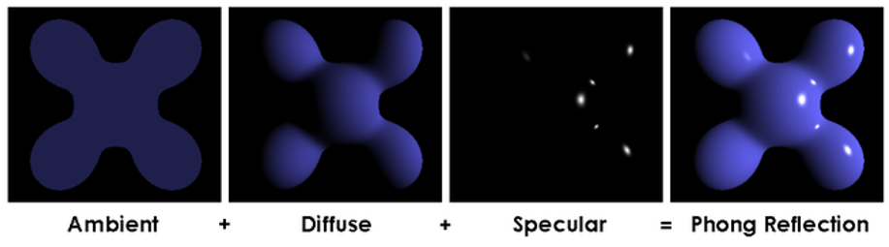




Shading & Lighting: Blinn-Phong Model Implementation
Lighting Model
Implementation Details
Our implementation uses the Blinn-Phong shading model to simulate realistic surface illumination by combining ambient, diffuse, and specular components for visually appealing results.
Material Properties
Defines ambientColor, diffuseColor, specularColor, and shininess to control how surfaces interact with light and influence overall appearance
Uniform Transmission
setInitialLighting function transmits lighting parameters to the shader program via uniforms
Performance Optimization
Normal Vector Importance
Pre-multiplies light and material colors to calculate ambientProduct, diffuseProduct, and specularProduct, streamlining the shading process
Computes normal matrix using inverse transpose of model-view matrix for accurate lighting during transformations
Ambient
Diffuse
Specular
CSCI 2408: Computer Graphics
ADA University. School of IT and Engineering
Highlights

Slide 8

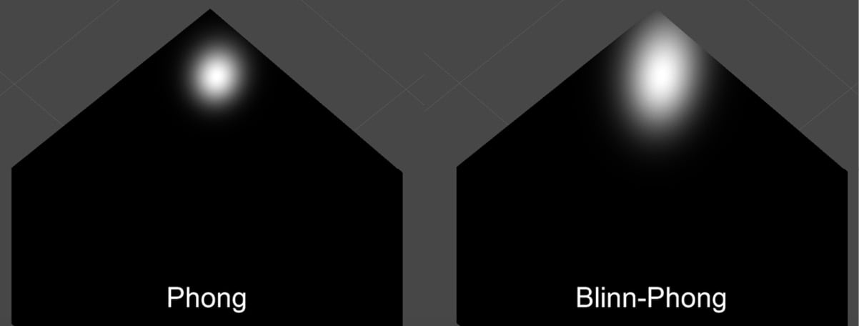




Shading & Lighting: Dynamic Illumination & Visual Cues
Dynamic Lighting
Visual Feedback System
Our implementation features an orbiting light source that creates dynamic lighting effects, enhancing the visual experience and realism of the simulation.
Animated Light Source
The light source orbits around the scene with its position controlled by currentTime and LIGHT_SPEED, creating dynamic shadows and highlights
Dynamic Color Assignment
Motes are assigned colors based on size relative to player using COLOR_LARGER and COLOR_SMALLER for gameplay awareness
Texture Binding
Managed through gl.activeTexture and gl.bindTexture, ensuring correct textures are applied to motes and the skybox for enhanced visual fidelity
Alpha Blending
Implemented for non-player motes, allowing transparency effects that add depth and improve visual distinction
Size-Based Colors
Transparency
Skybox Rendering
Dynamic Shadows
CSCI 2408: Computer Graphics
ADA University. School of IT and Engineering

Slide 9


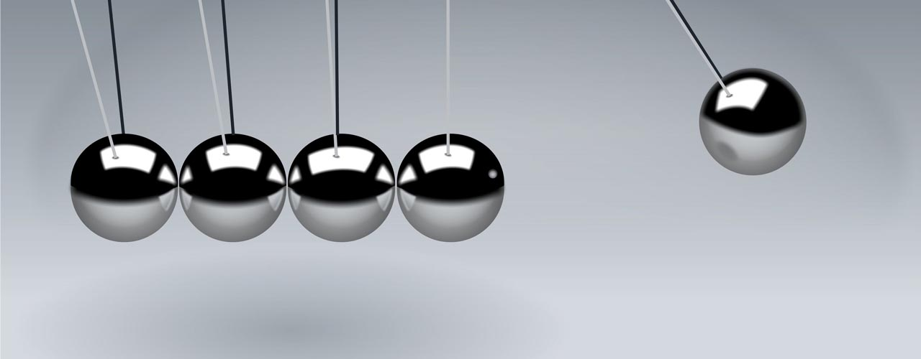





Motions & Physics: Player Control & Dynamic Forces
Player Movement System
Dynamic Forces
Our implementation features keyboard-based thrust controls that apply forces in camera-relative directions, creating responsive and fluid navigation within the 3D environment.
Input Handling
setupInput function establishes event listeners for mouse and keyboard inputs, allowing intuitive control of camera and player movement
Player Thrust Mechanics
W/S/A/D keys apply PROPULSION_FORCE in camera-relative directions, enabling responsive navigation
Drag & Damping
Velocity Integration
DRAG_COEFFICIENT is applied to playerMote's velocity, introducing deceleration and natural stopping effects for realistic motion
Player position updated using Euler integration, adding current velocity to position for continuous motion
Growth Animation
W - Forward
S - Backward
A - Left
lerp function smoothly transitions playerMote's radius after absorption, creating visually appealing growth effect
D - Right
CSCI 2408: Computer Graphics
ADA University. School of IT and Engineering

Slide 10


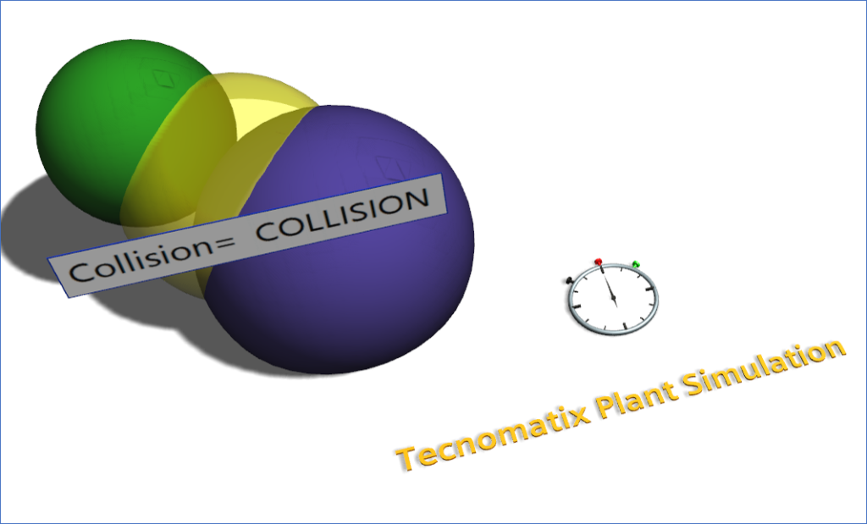





Motions & Physics: Advanced Collision & Absorption System
Absorption Mechanics
Collision Detection
Our implementation uses sphere-sphere collision detection with squared distance comparisons for efficient and accurate detection between motes, optimizing performance while maintaining gameplay integrity.
Collision Threshold
Volume-Based Growth
COLLISION_THRESHOLD parameter allows tuning of "softness" of collisions, enabling adjustments to gameplay dynamics and interaction sensitivity
Player mote grows by absorbing smaller motes, with targetRadius increasing based on combined volume of absorbed motes
Risk-Reward Dynamic
Dynamic Mote Status
Game over condition triggered if player is absorbed by larger mote, creating strategic gameplay decisions
updateEatableMotes() function re-evaluates which motes are absorbable based on player's growth, ensuring gameplay remains challenging as player evolves
Feedback System
Sound effects and visual cues provide immediate feedback when absorption occurs, enhancing player engagement
Collision Detection
Absorption Logic
CSCI 2408: Computer Graphics
ADA University. School of IT and Engineering
Growth Animation
Dynamic Status

Slide 11

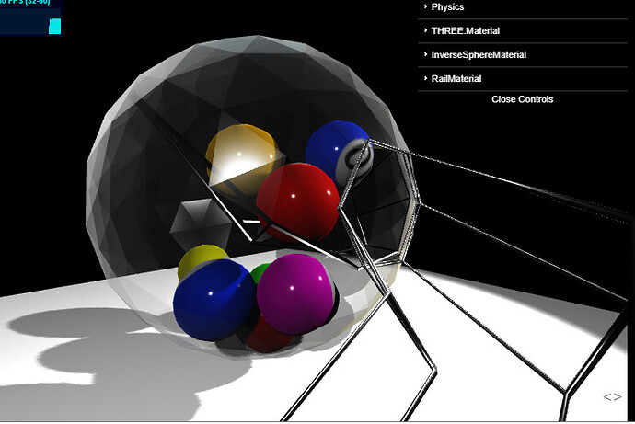



Motions & Physics: Environmental Interactions & Mote Dynamics
Environmental Boundaries
Mote Dynamics
Our implementation features skybox boundary collision detection that prevents the player from leaving the simulation space while creating realistic bounce effects when boundaries are reached.
Bounce Physics
When player collides with skybox boundary, velocity is reflected using normal vector calculations, simulating realistic bounce effects
Randomized Mote Rotation
Each mote assigned unique rotationAxis and rotationAngle, updated each frame to create dynamic visual movements
Physics Update Loop
Sound Integration
Dedicated updatePhysics() function runs independently of rendering, ensuring consistent and accurate physics simulations throughout gameplay
Audio feedback through eatSound for absorption and bgm for background music enhances immersive experience
Skybox Boundary
Bounce Effect
Independent Simulation
CSCI 2408: Computer Graphics
ADA University. School of IT and Engineering
Physics calculations separated from rendering pipeline, maintaining consistent motion regardless of frame rate
Dynamic Rotation
Audio Feedback

Slide 12










Future Directions & Acknowledgments
Acknowledgments
Potential Enhancements
We extend our gratitude to the following resources that guided us throughout this project:
Advanced AI System
Implement sophisticated AI behaviors for non-player motes with strategic movement patterns
Angel & Shreiner
Interactive Computer Graphics textbook for foundational WebGL concepts
Environmental Diversity
Introduce diverse environmental elements like obstacles, currents, and interactive terrain
MDN WebGL Documentation
Comprehensive reference for WebGL API and implementation patterns
Particle Effects
Stack Overflow
Add advanced particle systems for absorption events and visual feedback
Community solutions for UV mapping and texture handling challenges
WebGL Fundamentals
Multiplayer Capabilities
Tutorials for skybox implementation and advanced rendering techniques
Develop real-time multiplayer functionality for competitive gameplay
LearnOpenGL
AI Behaviors
Environment
Visual Effects
Multiplayer
Mathematical foundations for lighting, transformations, and physics
CSCI 2408: Computer Graphics
ADA University. School of IT and Engineering

Slide 13
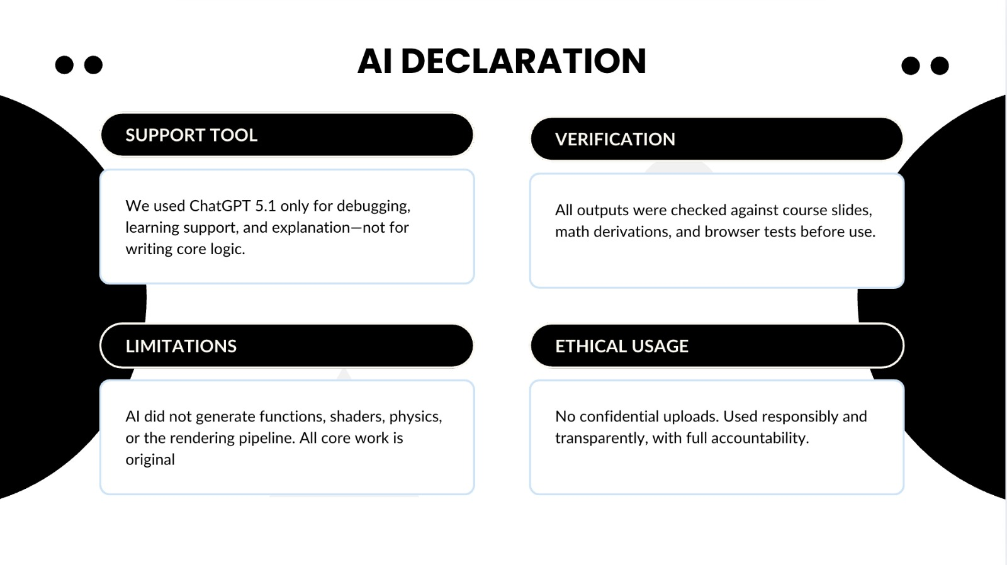


CSCI 2408: Computer Graphics
ADA University. School of IT and Engineering

Slide 14
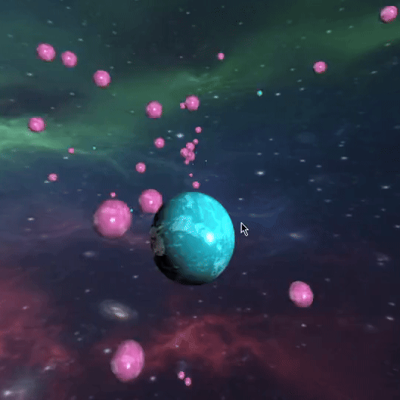
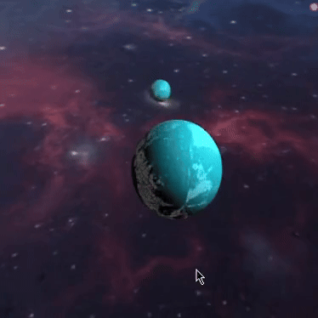
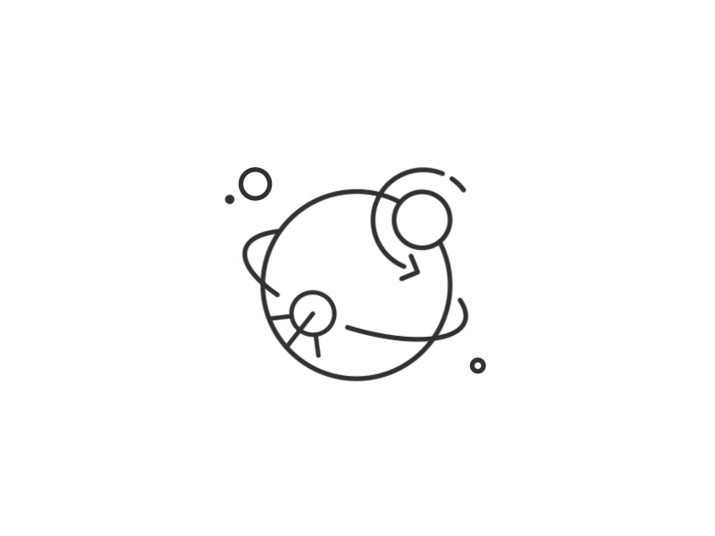
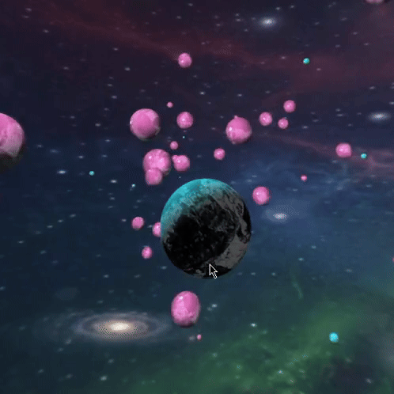
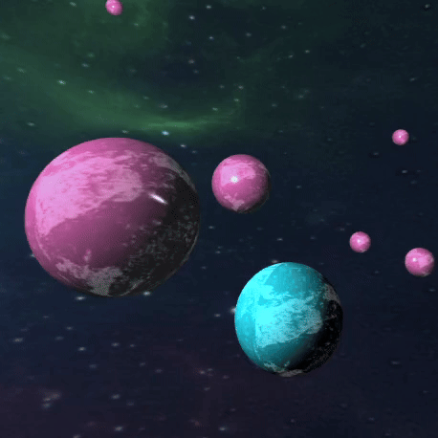
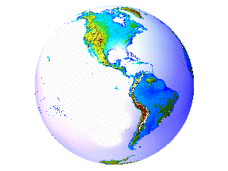


Slide 15







Technical Challenges Overcome
Key Learnings & Technical Challenges
UV Seam Correction
Key Learnings
Fixed texture artifacts at sphere poles by implementing seam correction techniques
WebGL State Machine
Deep understanding of WebGL's state machine behavior and proper resource management
Collision Detection
Developed efficient sphere-sphere collision detection with threshold tuning
3D Geometry Generation
Mastered procedural generation of smooth sphere meshes using recursive subdivision
Smooth Growth Animation
Shader Programming
Implemented lerp function for smooth radius transitions during absorption
Gained practical experience implementing Blinn-Phong lighting in GLSL
Physics Simulation
Camera Control
Developed real-time physics engine with collision detection and response
Created intuitive orbit camera system that tracks player while allowing rotation
Buffer Management
Texture Mapping
Performance
Visual Quality
Cross-browser
CSCI 2408: Computer Graphics
ADA University. School of IT and Engineering
Camera Controls
Absorption Mechanics
User Experience

Slide 16



